Slide 1
Find My Way
An Indoor Navigation System
By Group B:
Kruti Panchal (B00930563)
Princess Kachhadiya (B00969786)
Vishesh Patel (B00965836)

Slide 2
Purpose and Motivation
"Find my Way -- Dal" is a project that targets a critical aspect of university life: campus navigation. Specifically, it focuses on helping University students to navigate the complex and interior layouts of campus buildings.​
The main objective of this initiative is to enhance the overall campus experience by addressing the common challenges students face when trying to locate rooms, facilities, or events within buildings.​
The project aims to design and develop a user-centered campus navigation app that leverages combined mobile and large-screen devices.​
By considering the use of existing structures and potentially incorporating technologies such as sensors or augmented reality (AR), the project seeks to create a seamless and intuitive navigation experience.

Slide 3
Purpose and Motivation
Understand user needs and design an application that meets their expectations.​
For this project, the user studies already carried out for indoor navigation were studied. Since this is user-centered, this helps understand user needs better and identify challenges. Moreover, contextual inquiries/interviews were carried out to understand the problems the users face in particular.​
The purpose of doing all these is to learn about the diverse needs of users, including those with disabilities, and incorporate accessibility features into the UX design to ensure inclusivity and usability for all students.

Slide 4
Approach
Literature review
Contextual Inquiry
Affinity Diagram
Sketch and Storyboard
Designing low-fidelity prototype
Cognitive walkthrough

Slide 5
Summary of Contextual Inquiry
Challenges Identified:
Difficulty in indoor navigation, particularly for new users.
Lack of clear signs and maps inside the building.
Finding the quickest route.
Need For
Detailed and up-to-date indoor navigation apps
Customized according to user preference
Integration of personal schedule and real-life updates for efficient route planning

Slide 6
Affinity Diagram
The 9 themes formed by the affinity diagram were:​
Navigational signs​
Navigating with Google Maps​
Application Usability​
Personalized App Interface​
Audio Assistance in Navigation​
Visual Aids in Navigation​
Issues in Traditional Methods​
Accessible Navigation for BVI (Blind and Visually Impaired) Users​
Traditional Navigation Approach​

Slide 7
Guidelines for prototype
Visual aid for indoor navigation: This feature enhances indoor navigation by dynamically highlighting key facilities like study rooms or dining areas within a building based on the current time. It adapts to users' needs, showing them the most relevant places during different hours of the day.
Audio Assistance for Indoor Navigation: This feature provides verbal directions to help users navigate inside campus buildings. It guides users through audio cues, making it easier to move from one location to another without relying on visual maps.
AR Navigation via Signage Scanning: This utilizes augmented reality (AR) technology. Users scan a navigation sign to establish their location. Then, the system overlays a virtual path on their device’s screen, leading them to their chosen destination in the building.

Slide 8
Demonstration
Prototyping link - demonstration

Slide 9
Cognitive Walkthrough
The task for each feature:
Indoor Navigation Visual Aid
Indoor navigation using audio assistance
AR Campus Navigation using navigation signs
For each feature
Task scenario
Normal Use case
Alternate Use case
Prototype

Slide 10
Cognitive Walkthrough
The Three Questions
Will the user know what to do?
Will the user see how to do it?
Will the user understand the correct action?

Slide 11
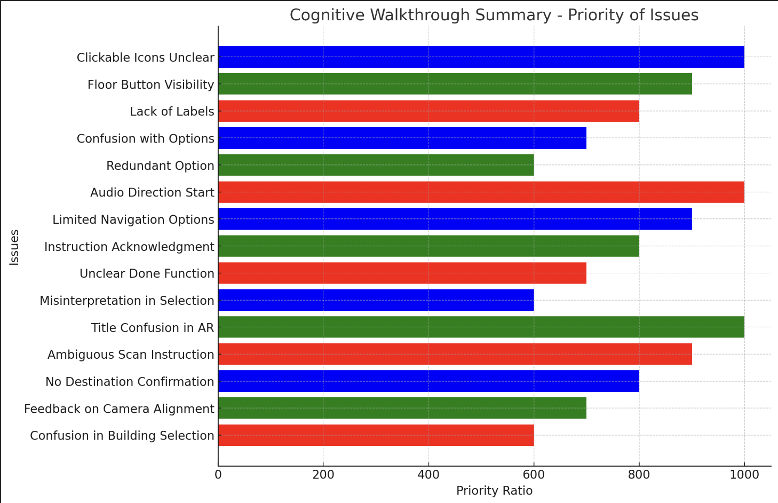
Cognitive Walkthrough summary

Slide 12
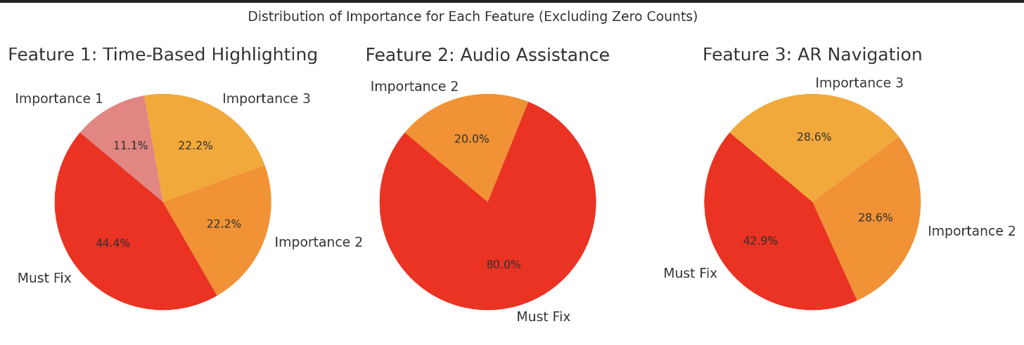
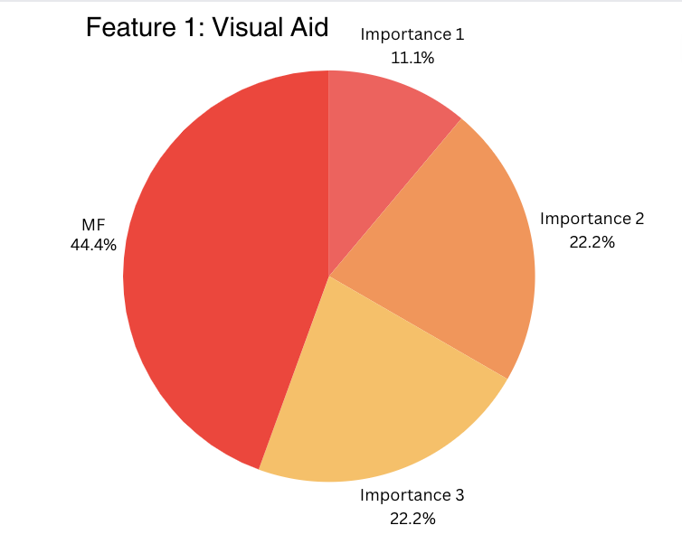

Cognitive Walkthrough summary

Slide 13
General Findings
Indoor navigation is challenging due to similar-looking structures and inadequate signage.
There’s a diverse range of user needs, highlighting the importance of accessibility and various navigation aids.
Users greatly value real-time updates in the navigation system for accurate information.
A strong preference for intuitive, user-friendly interfaces in navigation apps is evident.
Customizable navigation options are in demand, allowing users to tailor their experience.
Incorporating advanced technologies like augmented reality can enhance navigation effectiveness and engagement.

Slide 14
Suggestions
Arrange buttons and options in a way that makes them easy to find and understand, avoiding confusion.
Place easy-to-understand labels on all key features to help users quickly recognize their functions and locations.
Include brief explanations or tips next to options and buttons to guide users on how to use them effectively.
Provide instant messages to confirm if a user's action, like scanning a QR code, was successful or not, enhancing user confidence.

Slide 15
References
[1] | Tony Shu-Hsien Wang, Dian Tjondronegoro, Michael Docherty, Wei Song, and Joshua Fuglsang. 2013. A recommendation for designing mobile pedestrian navigation system in university campuses. In Proceedings of the 25th Australian Computer-Human Interaction Conference: Augmentation, Application, Innovation, Collaboration (OzCHI '13). Association for Computing Machinery, New York, NY, USA, 3–12. https://doi.org/10.1145/2541016.2541039
[2] | Arto Puikkonen, Ari-Heikki Sarjanoja, Merja Haveri, Jussi Huhtala, and Jonna Häkkilä. 2009. Towards designing better maps for indoor navigation: experiences from a case study. In Proceedings of the 8th International Conference on Mobile and Ubiquitous Multimedia (MUM '09). Association for Computing Machinery, New York, NY, USA, Article 16, 1–4. https://doi.org/10.1145/1658550.1658566
[3] | Prashant Verma, Kushal Agrawal, and V. Sarasvathi. 2020. Indoor Navigation Using Augmented Reality. In Proceedings of the 2020 4th International Conference on Virtual and Augmented Reality Simulations (ICVARS '20). Association for Computing Machinery, New York, NY, USA, 58–63. https://doi.org/10.1145/3385378.3385387
[4] | “Figma,” Figma. https://www.figma.com/files/recents-and-sharing/recently-viewed?fuid=1291148235851249892 (Accessed Apr. 01, 2024).

Slide 16
[5] | Canva. “Pie Chart Maker .” Canva, [Online]. Available: www.canva.com/. Accessed 31 Mar. 2024.

Slide 17
Any Questions?

